Slide 1

Welcome to Edu-Academy
website Project

Slide 2

This website was developed by students of Youth Enablement for Freelancing
Sponsored by Ministry of Communications and Information Technology.
By:
Eng. Mohamed Gaber Meabed
Eng. Ahmed Hassan El-said
Eng. Ayat Nabil Hamed
Eng. Bassem Kamal Iskandar
Eng. Mona Muhammed Al-Gharib
Supervised by:
Eng. Mahmoud Ali

Slide 3

About this file
The purpose of this file is to provide overview, setup instructions and background information of the project.
This is an Educational website project where you can add all the Academy information , last news , Academy history and how to communicate with the Academy.
Also it helps Students to enroll in different courses , contact with instructors , register and attend different events.
Target audience: The project will help the website owners , Students , teachers and Parents to communicate with each others.

Slide 4

Software requirements
1) An operating system such as Windows or Mac. 2) An Internet Explorer such as Google Chrome or Firefox. 3) Http Server. 4) MySQL and MySQL drivers.
Hardware requirements
1) Minimum 4 GB RAM. 2) Minimum 10 GB Available Disk Space. 3) Wi-Fi Availability.

Slide 5

This Project uses Laravel Framework
&
Other Programming languages Used
HTML CSS
JavaScript Ajax
php
MySQL

Slide 6

Setup Instructions
Fetching git code to local system
Start the http and MySQL xampp server
Clone the repository from GitHub
https://github.com/MohamedGMeabed/Auth_laravel
Change current working directory to Project directory cd Auth_laravel
Inside the project file install composer
composer install
Add Key
php artisan key:generate
Start Server
php artisan serve
Database is Attached with the project
Import Database

Slide 7


Site Map
Home
index
Contact Us
contact-us
About US
about-us
Courses
courses
Events
events
Sliders
slider
Course Registration
course_register
Course Details
course_details
Event Details
event-details
Event Registration
event_register

Slide 8
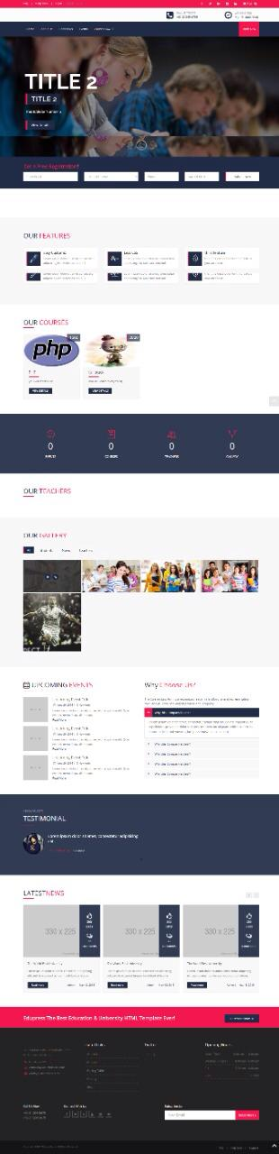

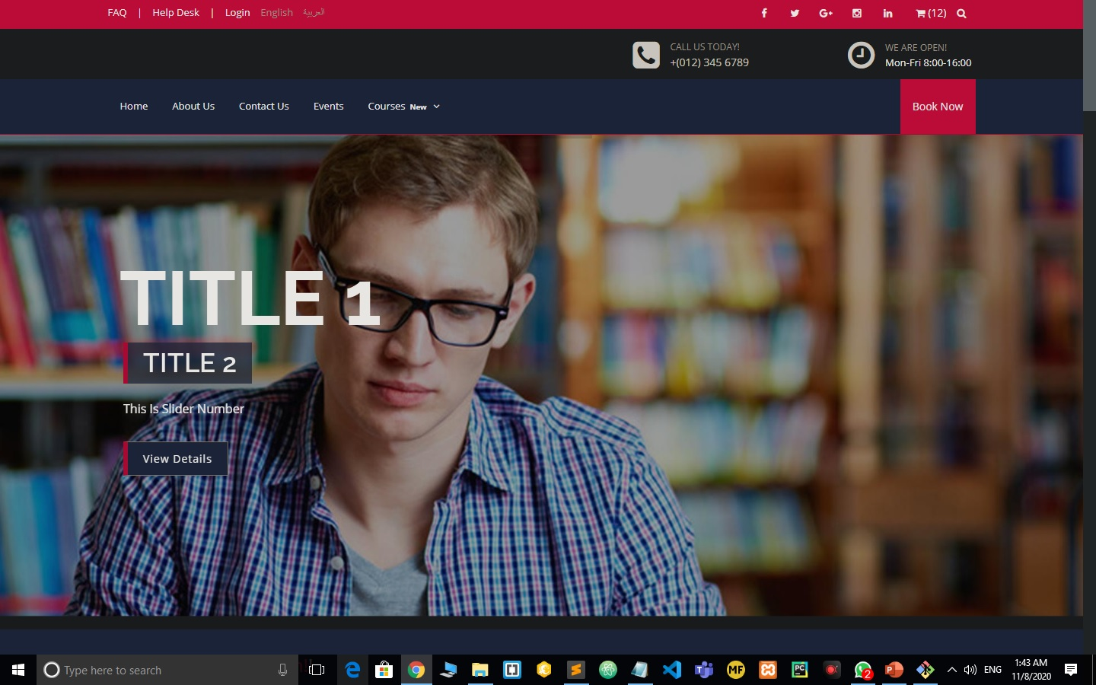
Home Page
Welcome to our Home page ,From Header visitors can easily choose their preferred language.

Slide 9
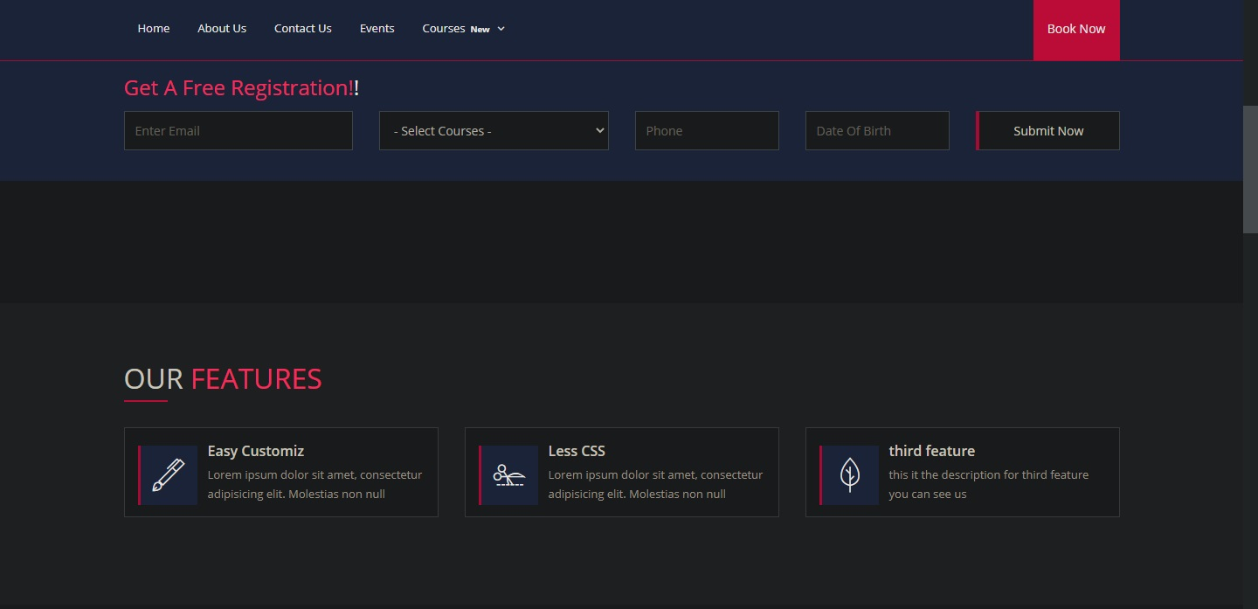
Home Page
Free Registration and Site’s Features.

Slide 10
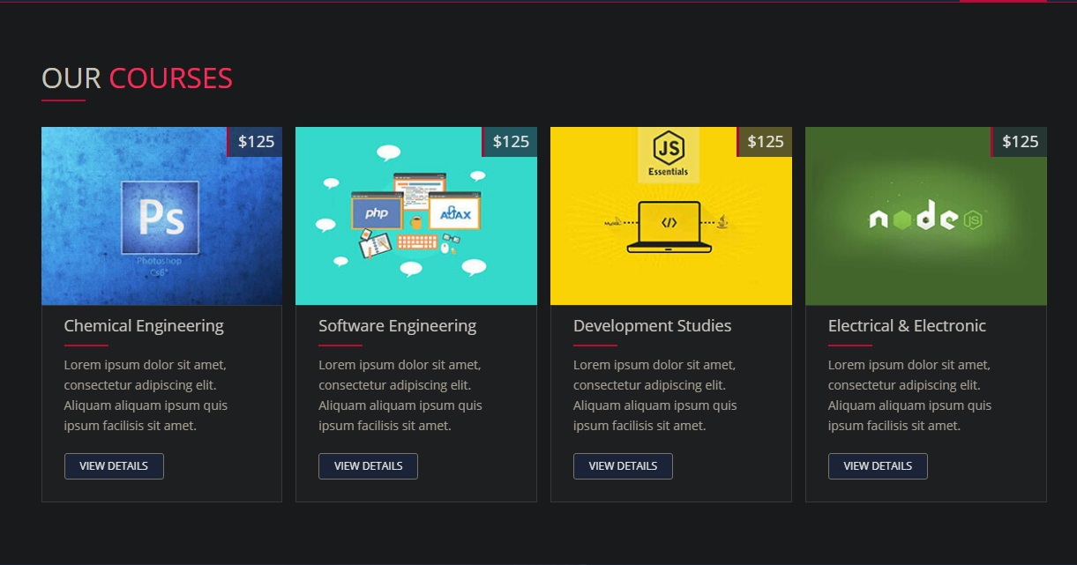
Home Page
The Available Courses.

Slide 11
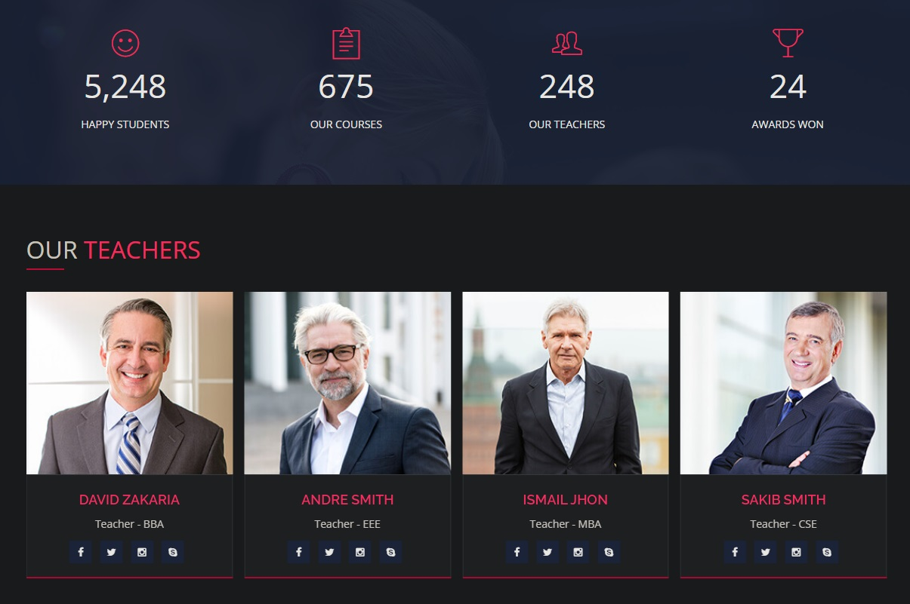
Home Page
Site Stats and Available Instructors.

Slide 12

Home Page
Our Photo Gallery.

Slide 13
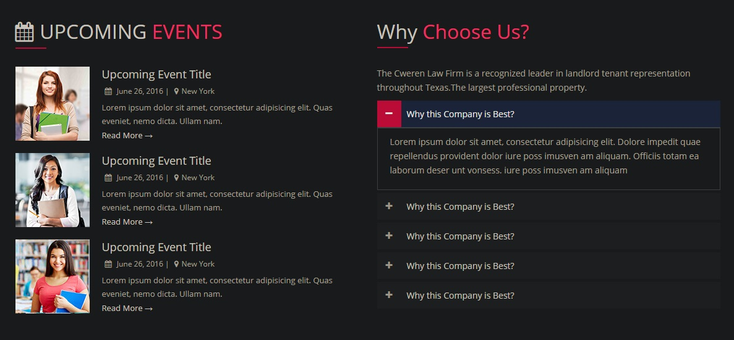
Home Page
Upcoming Events and Why you choose us section.

Slide 14
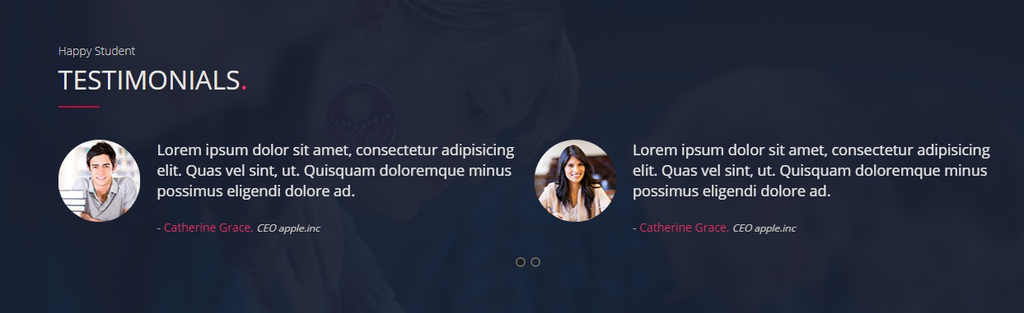

Home Page
Testimonials.

Slide 15
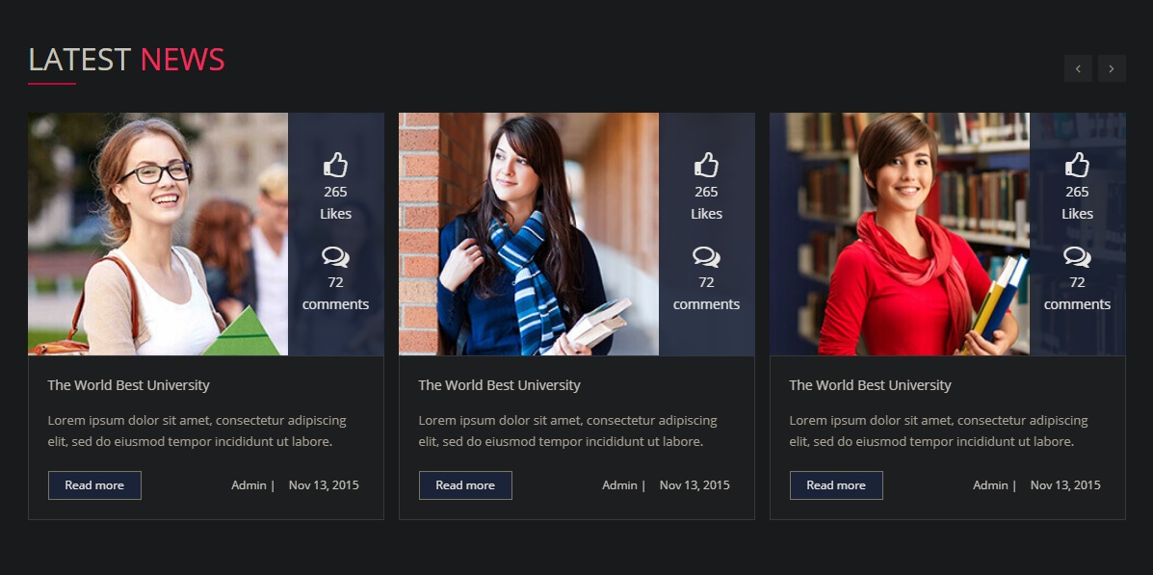
Home Page
Latest News.

Slide 16
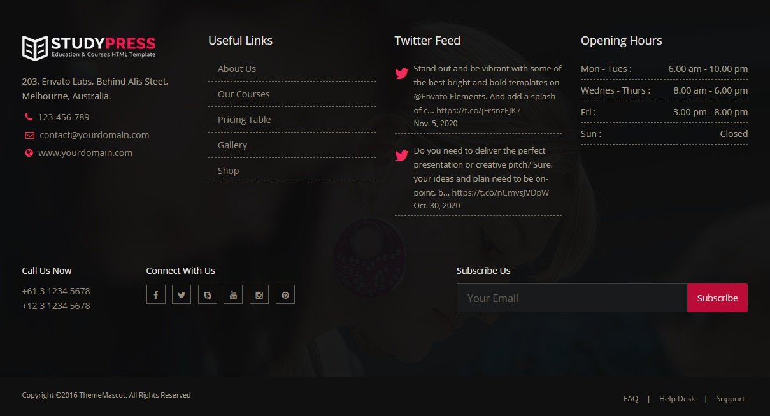
Home Page
Footer.

Slide 17

About Us Page
Here you can know everything about Edu-Academy.

Slide 18
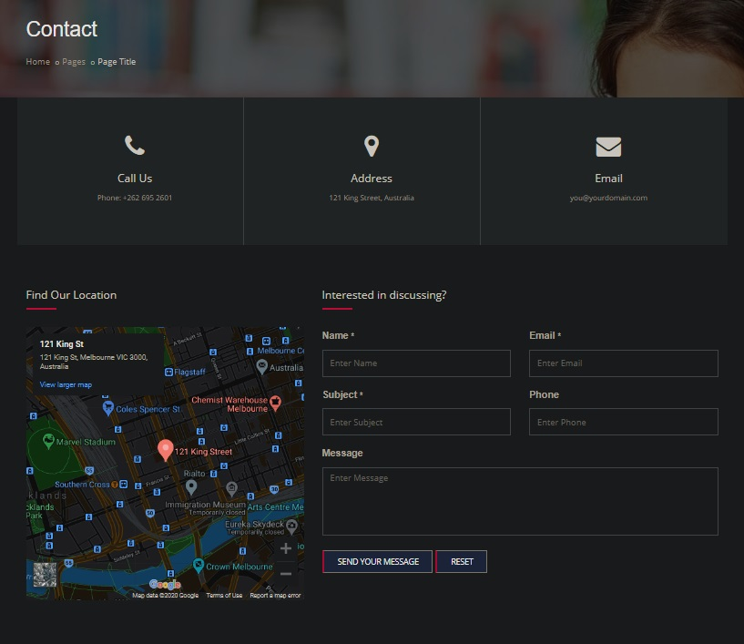
Contact Us Page
Contact Us page and where you can find us.

Slide 19
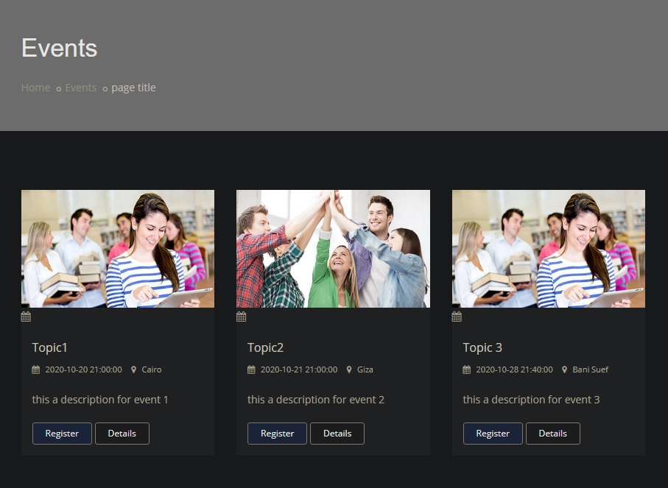
Events Page
All Upcoming Events Will Appear Here.

Slide 20
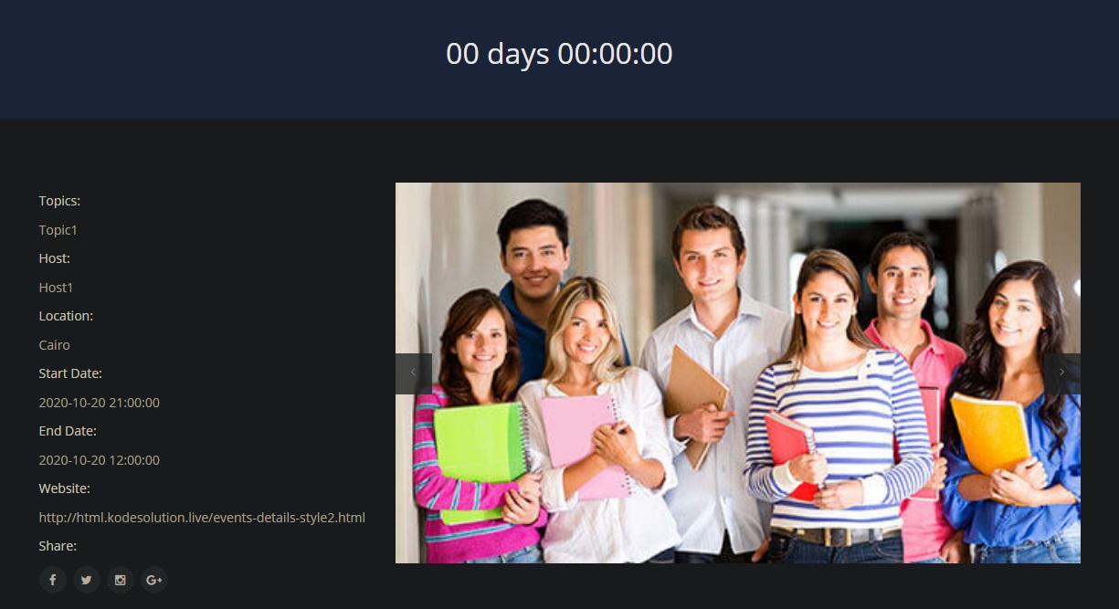

Event Details Page
Here You will find Event Details and Description.

Slide 21
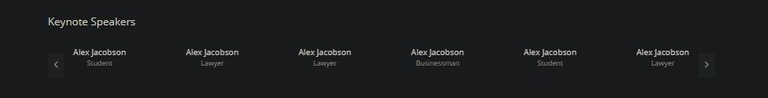
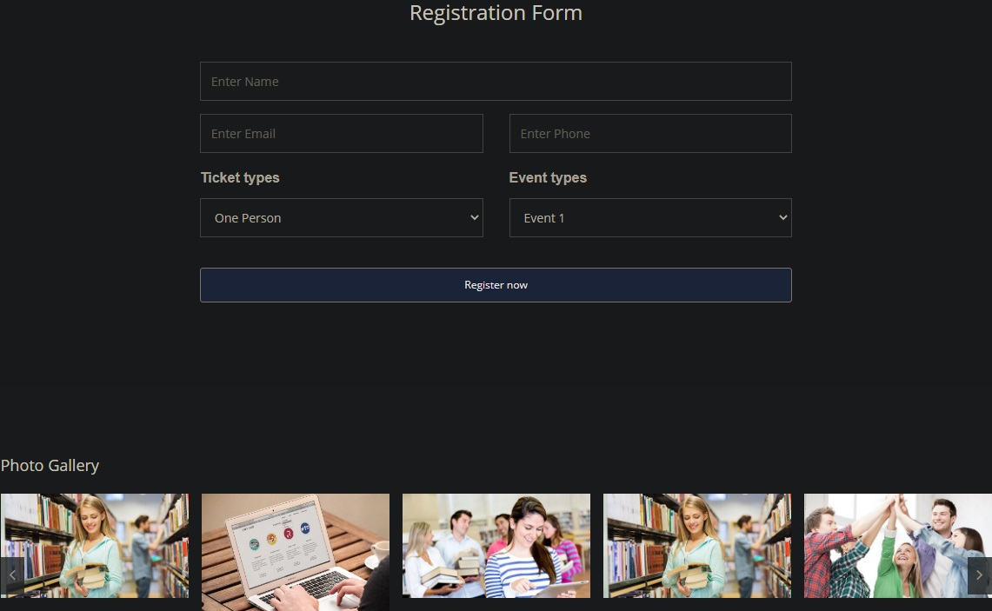
Event Details Page
Event Speakers.
Registration Form and Event Photo Gallery.

Slide 22

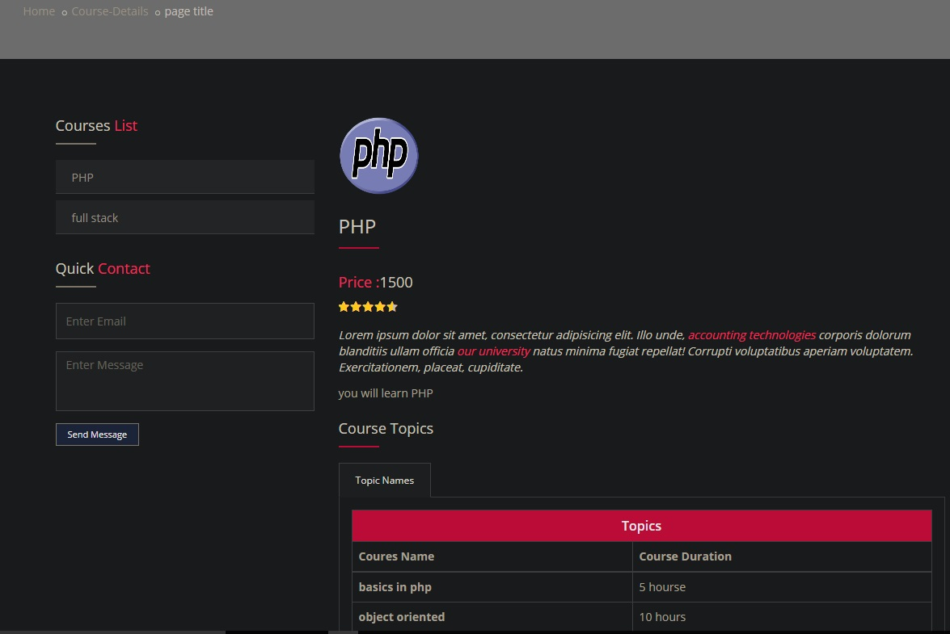
Course Details Page
This page Shows All Course Details and topics.

Slide 23
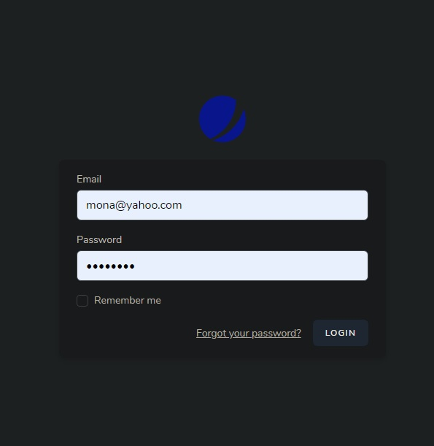
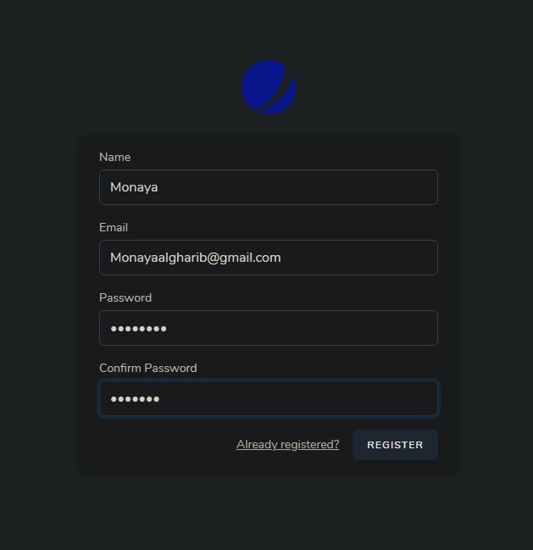
Admin Overview
Easy Login and Register.

Slide 24
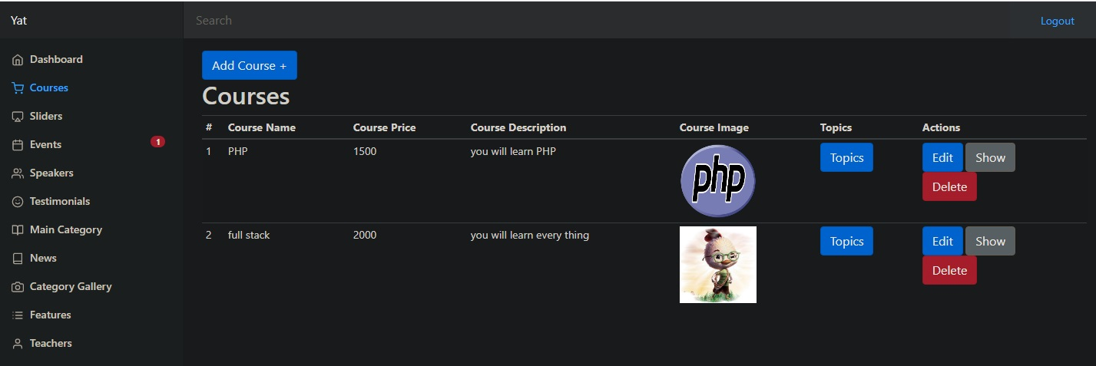
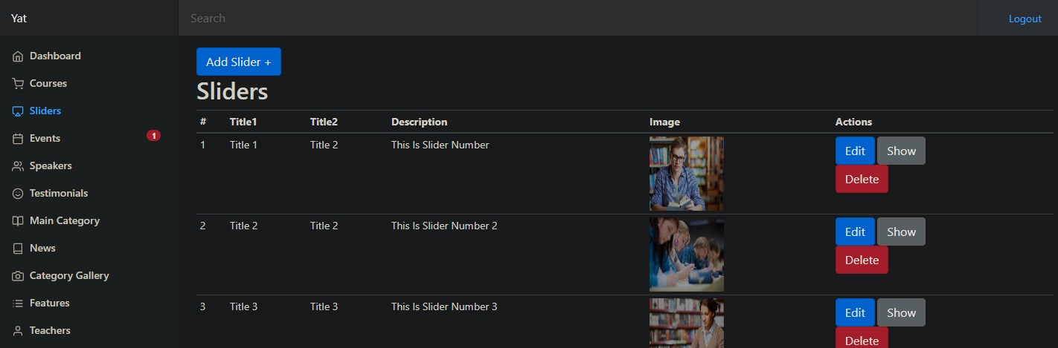
Admin Overview
Easy Add , Edit , Show and Delete Courses.
Easy Add , Edit , Show and Delete Sliders.

Slide 25
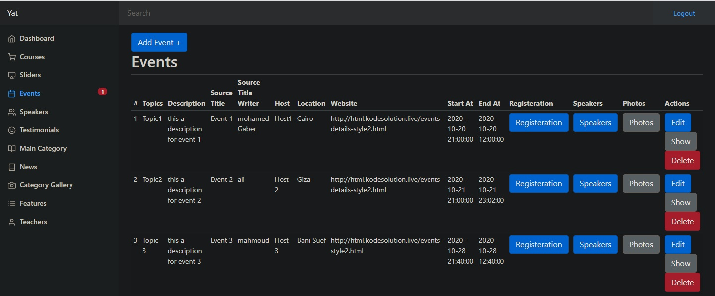
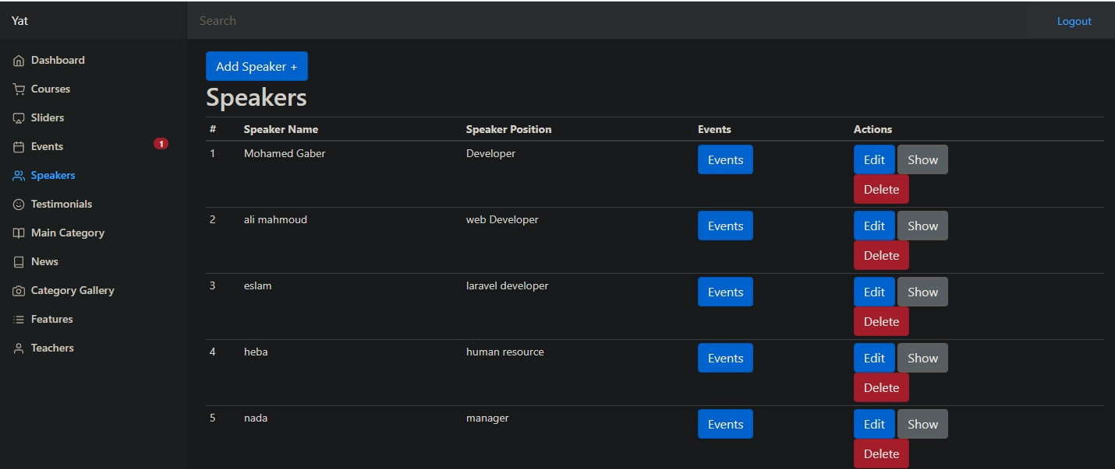
Admin Overview
Easy Add , Edit , Show and Delete Events.
Easy Add , Edit , Show and Delete Speakers.

Slide 26
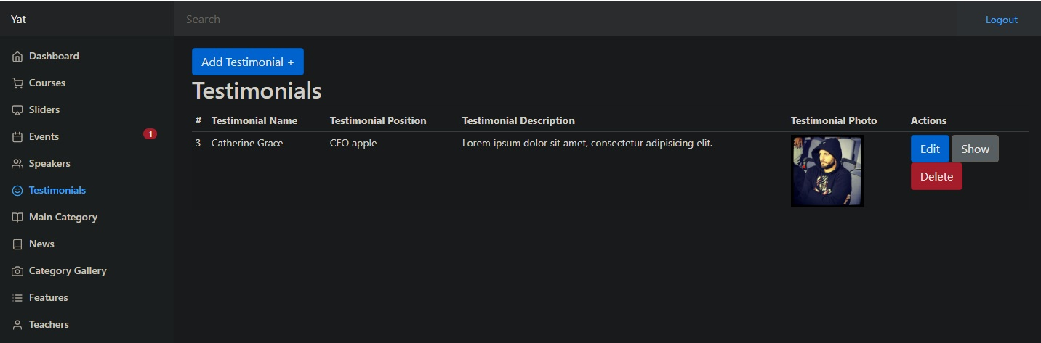
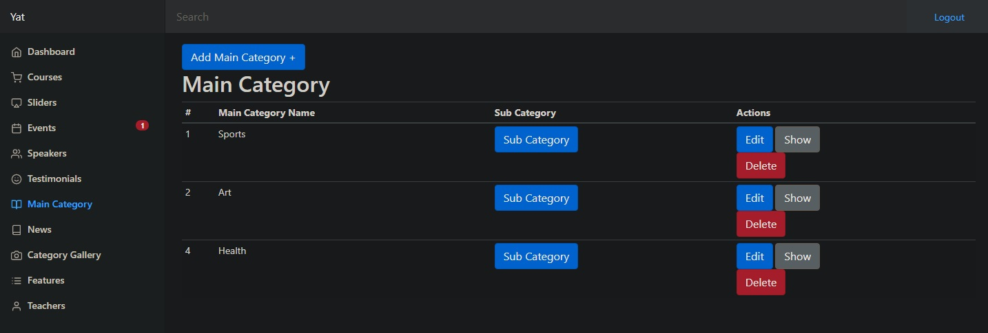
Admin Overview
Easy Add , Edit , Show and Delete Testimonials.
Easy Add , Edit , Show and Delete Categories.

Slide 27
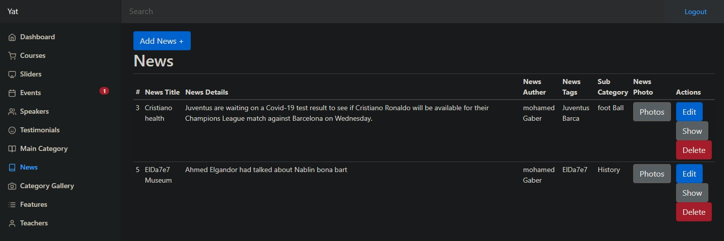
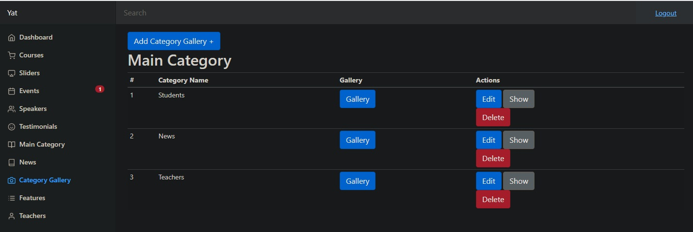
Admin Overview
Easy Add , Edit , Show and Delete News.
Easy Add , Edit , Show and Delete Photos Categories.

Slide 28
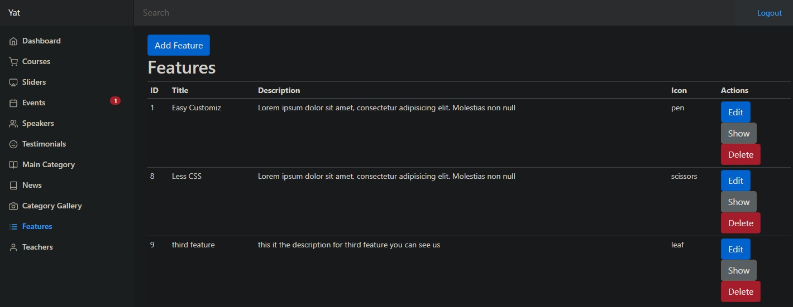
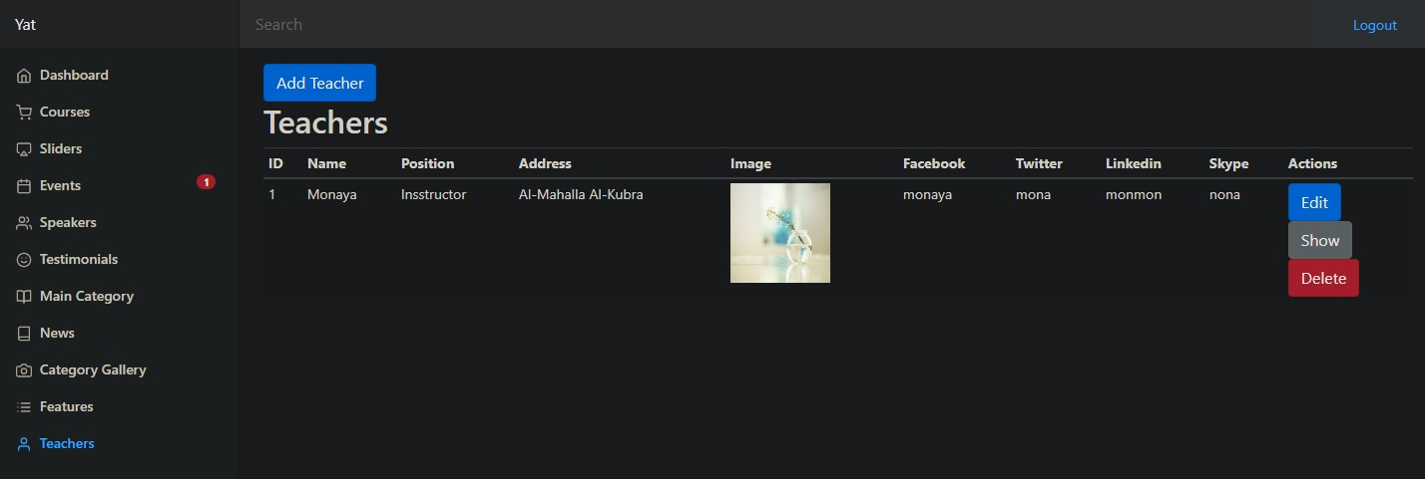
Admin Overview
Easy Add , Edit , Show and Delete site Features.
Easy Add , Edit , Show and Delete Teachers.

Slide 29
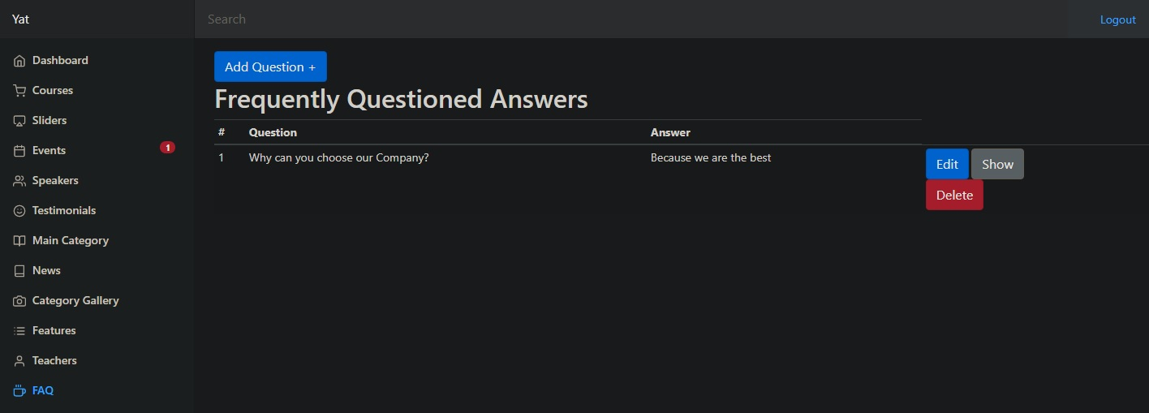
Admin Overview
Easy Add , Edit , Show and Delete site FAQ.

Slide 30

References
Icons needed For admin/features
https://www.themes-pixeden.com/font-demos/7-stroke
GitHub Link for the Project
https://github.com/MohamedGMeabed/Auth_laravel
GitHub Link for Documentation
https://github.com/Monayaty/EduAcademy

Slide 31

Thank you for completing our little tour, Hoping that you like our Project.
Many thanks to:
Ministry of Communications and Information Technology.
Yat Learning.
Many thanks to:
Eng. Mahmoud Ali.
Have a nice Day

